Slide 1

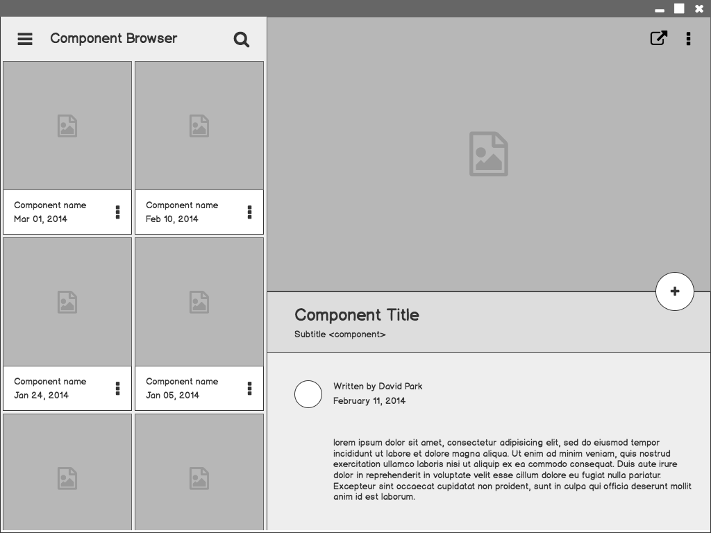


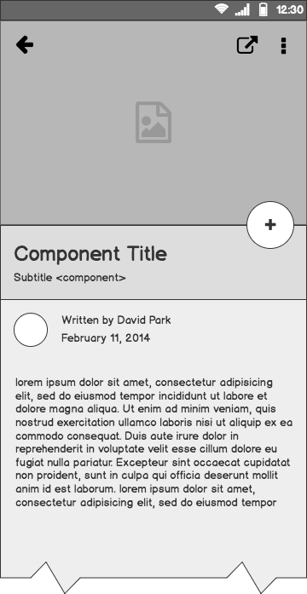
APCA STORE
SOFTWARE ENGINEERING PROJECT
A Gym based E-Commerce website
CS31 | G-17

Slide 2




CONTRIBUTIONS
Dharavath Anvesh
1901059
D.Gouri Pranay
1901060
Chandra Shekhar kurra
1901094
M.V.S.Sai Abhiram
1901099

Slide 3
CUSTOMER

Slide 4
Overview
Due to the recent pandemic situation, it would be safe for customers and sellers to buy and sell the products in a hands-free manner and protect themselves from covid. The purpose of developing this “APCA Store” is to ease the process of buying gym equipment for gym fitness freaks and work their body from home even when they can’t reach the physical gym.
The scope of this website is over a Region. We aim to provide quality equipment for people living in rural areas too. Expanding the segment's target market to a larger audience from fitness enthusiasts to additional consumers looking to improve their overall health.

Slide 5
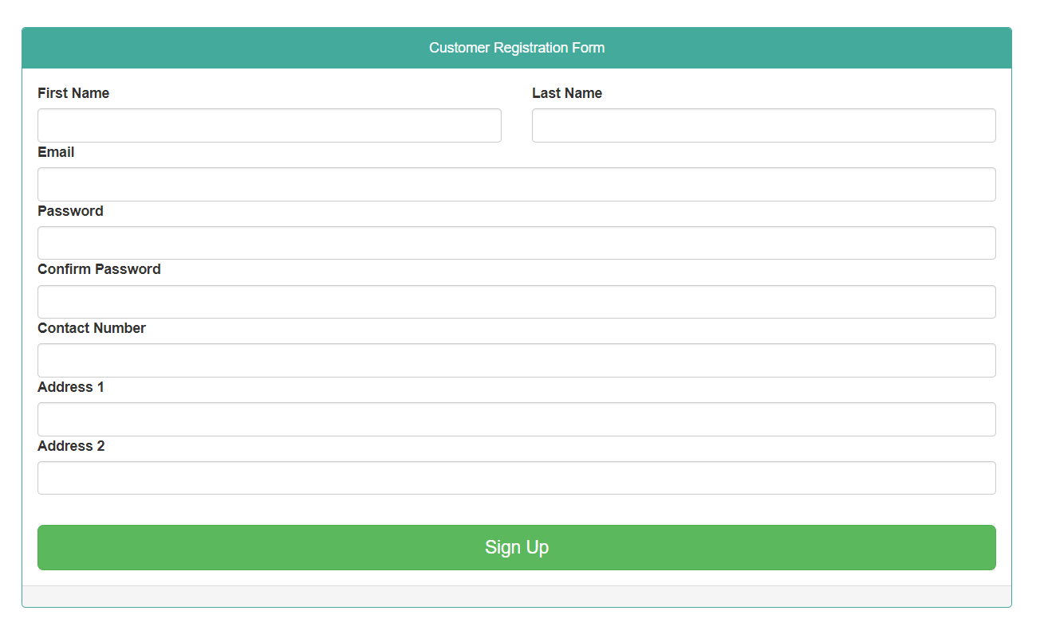
CUSTOMER REGISTRATION PAGE
1
Customers can fill the basic details and register a new account .
Basic details like Name , email , address etc are needed to create a new account .
After the customer registers a new account he/she would be directly redirected to the home page .

Slide 6
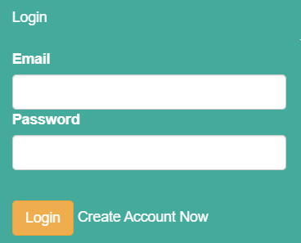
CUSTOMER LOGIN PAGE
1
Customers can login through this page.
All they have to do is to fill the details like email and password.
And after they log-in they would be redirected to home page i.e product listed page.
If the customer haven’t registered the account then they have an option to create a new one.

Slide 7
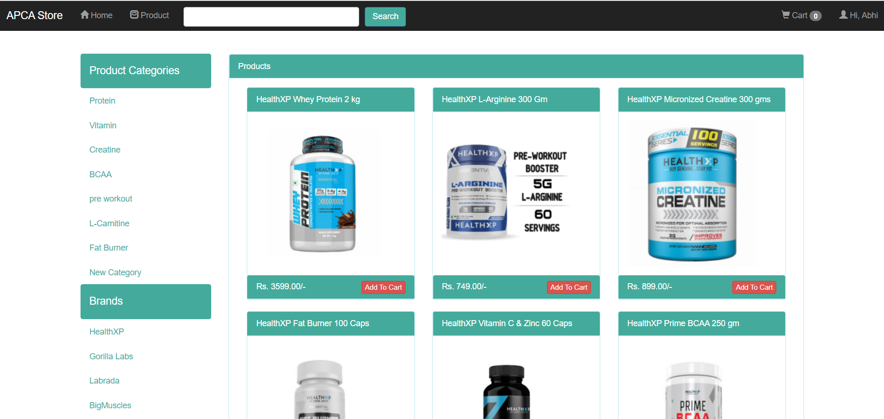

APCA STORE - Home page
CUSTOMER HOME PAGE
PRODUCTS ( Health xp creatine)
Customer home page | APCA STORE - Home page

Slide 8
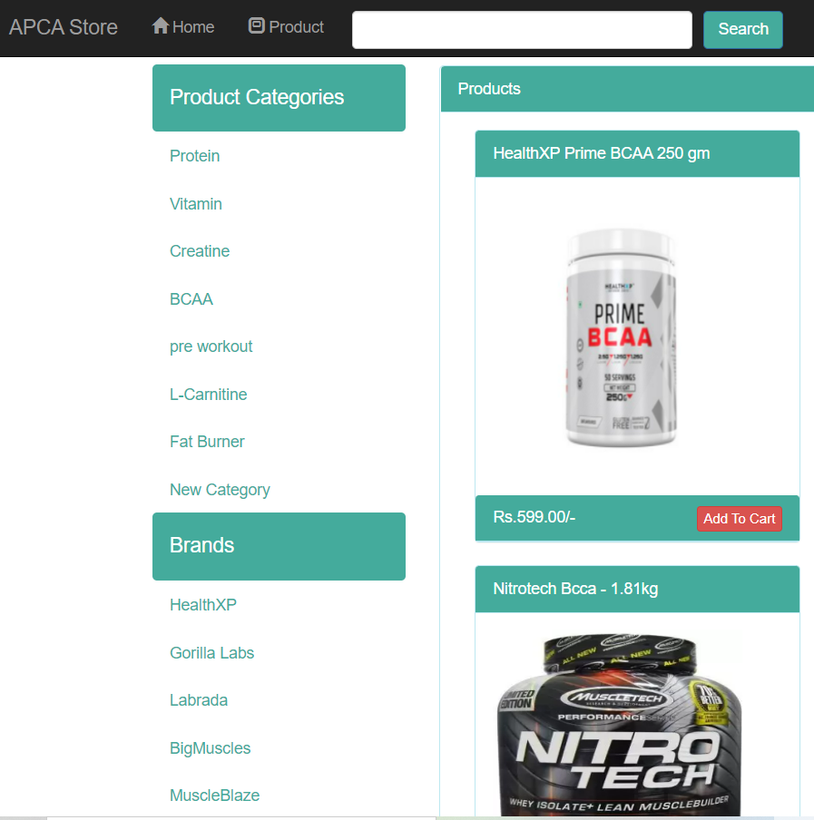
FEATURES TO EASE SHOPPING
1
To ease the shopping experience we have provided the category and brand filters .
The search option is really a powerful way to save time and directly check the specific product
Customer can use home button while viewing their cart to redirect to the APCA STORE home page .
After filtering/searching the customer can directly add the product to the cart.

Slide 9
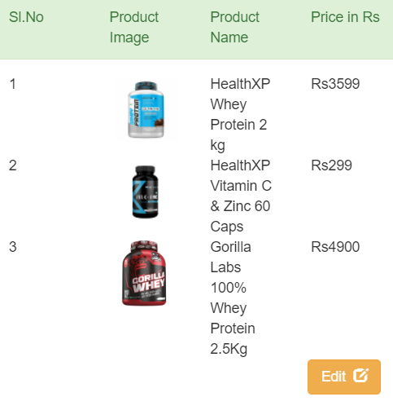
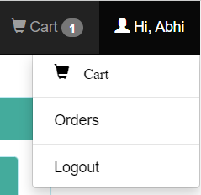
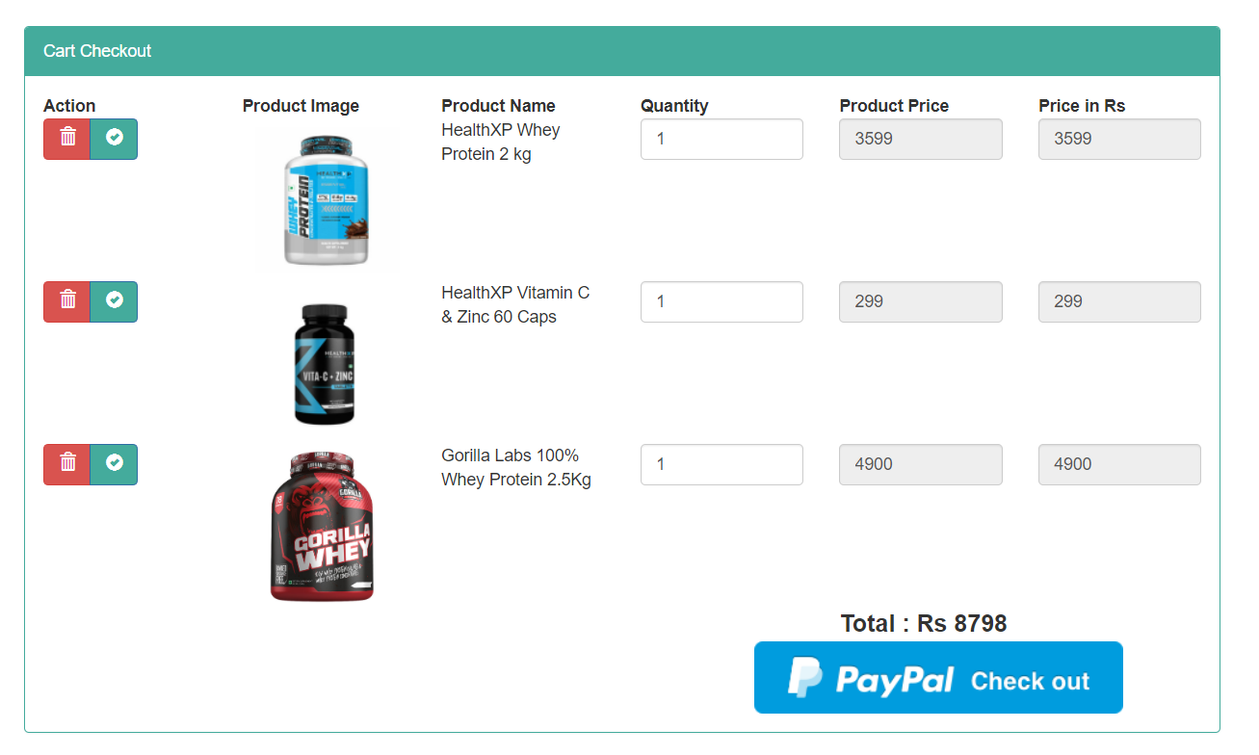
ALL ABOUT THE CART AND ORDER
Customers can view their cart in which the products selected earlier were added.
Details of the products such as name, image, quantity, price are made visible to make customers verify their cart.
The customers are even provided by edit option .Upon clicking on the “Edit” the customer would be redirected to cart checkout page.
Here customers can increase /decrease the quantity of the product and delete option is even provided to totally remove the specific product from the cart .
Customers can check their previous orders by clicking on “Orders” option.

Slide 10
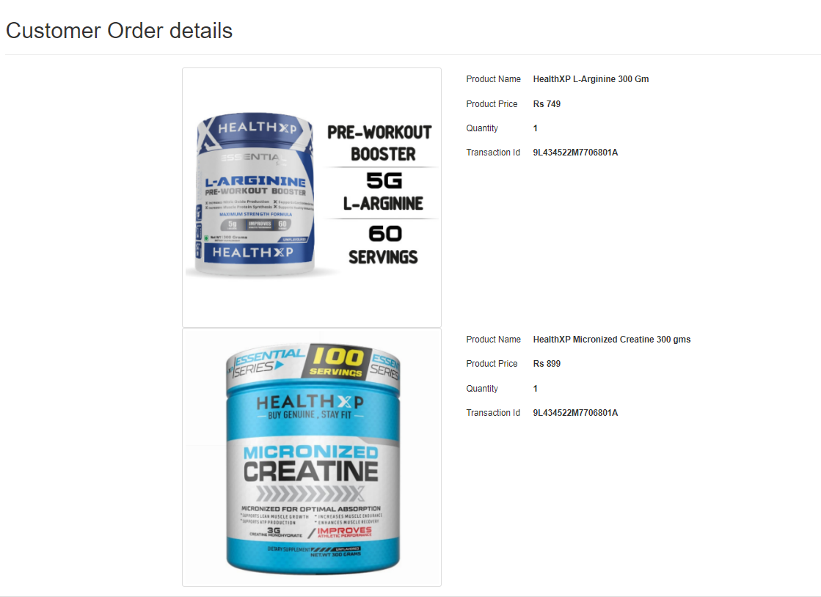
APCA STORE - Previous orders
Previous orders
The details about the previous orders would be displayed on clicking upon the “orders”.
Product name , product price , quantity , Product image , transaction id are provided to the customer.
The order history would only be visible upon successful payment .

Slide 11
ADMIN

Slide 12
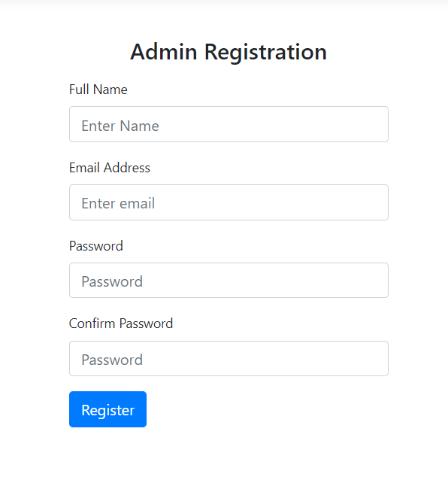
ADMIN REGISTRATION PAGE
Only existing admins can access to this admin portal through which registration is possible for new admins
Admin can fill the basic details and register a new account .
Basic details like Name , email , password are needed to create a new account .
After the admin registers a new account he/she would be directly redirected to the dashboard of the admin panel .
1

Slide 13
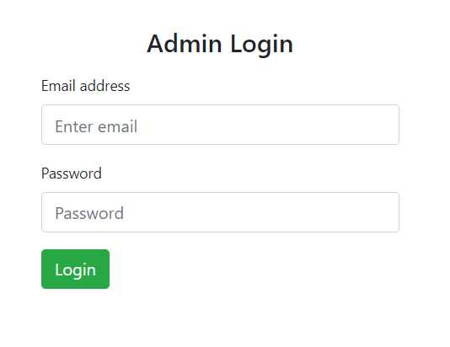
ADMIN LOGIN PAGE
1
Admins can login through this page.
All they have to do is to fill the details like email and password.
And after they log-in they would be redirected to admin panel dashboard.

Slide 14
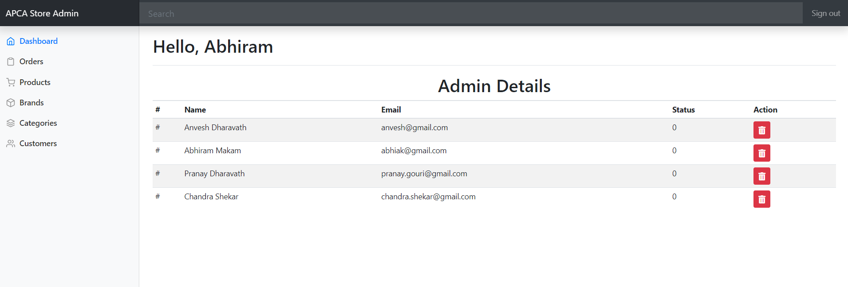
APCA STORE - Previous orders
Admin panel - Dashboard
There are set of operations that can be performed by the admin panel.
The dashboard can be used to check the list on the admins , check their status , delete admin from the panel.

Slide 15
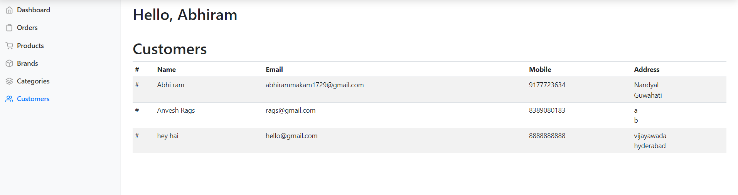
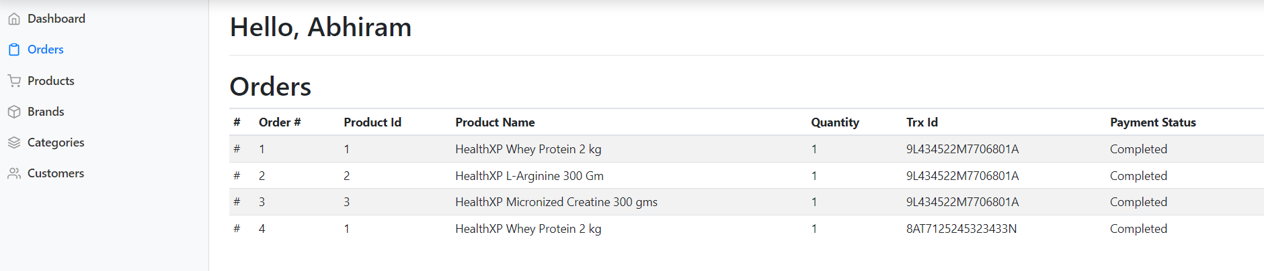
APCA STORE - Previous orders
Admins can view the registered customer details like name, mobile number, address etc but confidential details such as password cannot be viewed.
Admin can view the orders made by the customers including the transaction id, product id, product name, quantity and payment status.

Slide 16
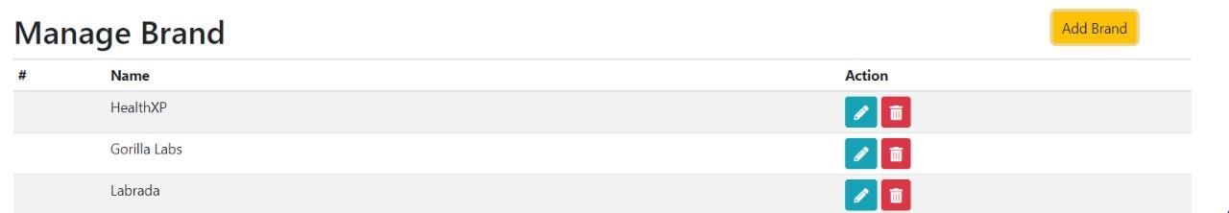
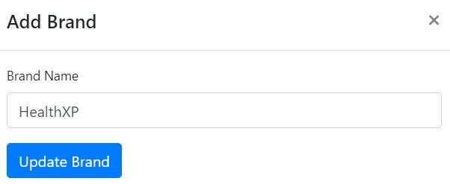
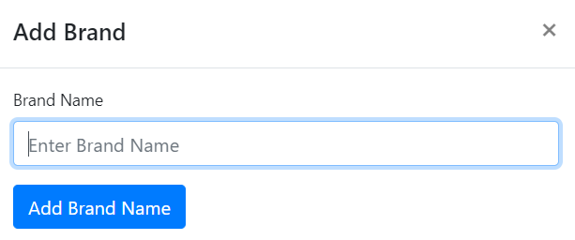
APCA STORE - Brand page
Admin panel - Brands
Admin can make actions such as updating or deleting an existing brand, adding a new brand.
Existing brand can be updated (change the name ) by clicking on the edit option. Brand can be deleted by using the delete option.
A new brand can be added by clicking the “Add Brand” option .

Slide 17
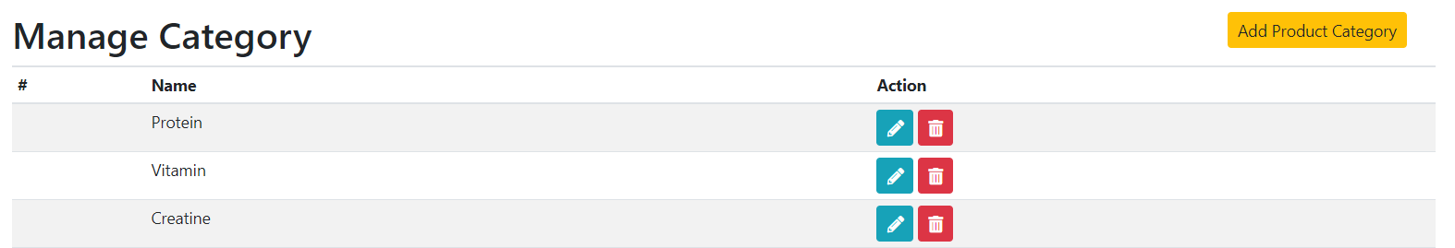
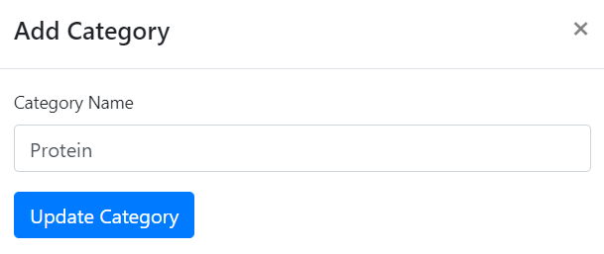
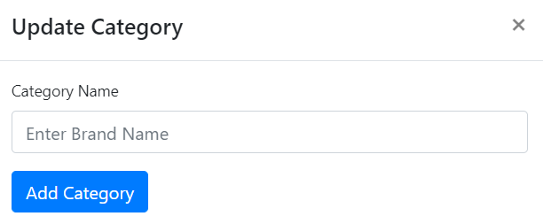
APCA STORE - Brand page
Admin panel - Category
Admin can make actions such as updating or deleting an existing category, adding a new category.
Existing category can be updated (change the name ) by clicking on the edit option. Category can be deleted by using the delete option
A new category can be added by clicking the “Add Product Category” option .

Slide 18
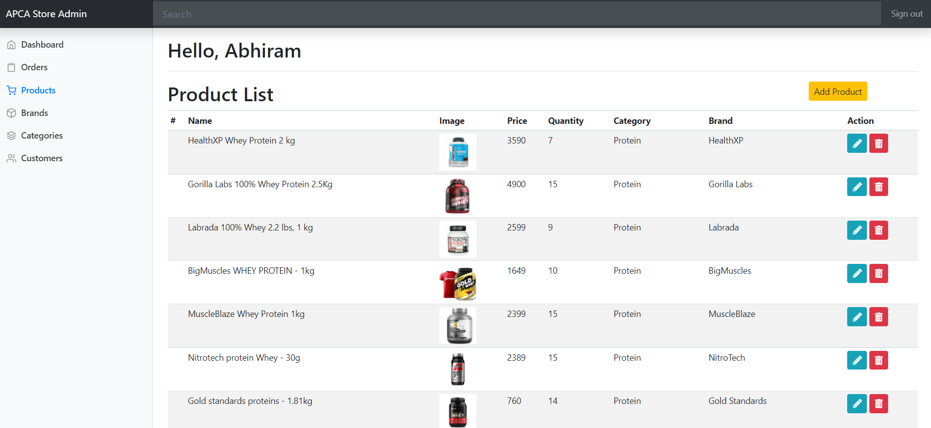
Admin panel - Product
A new product can be added from the product section and existing product can be edited / deleted .
ADMIN PANEL -PRODUCT

Slide 19
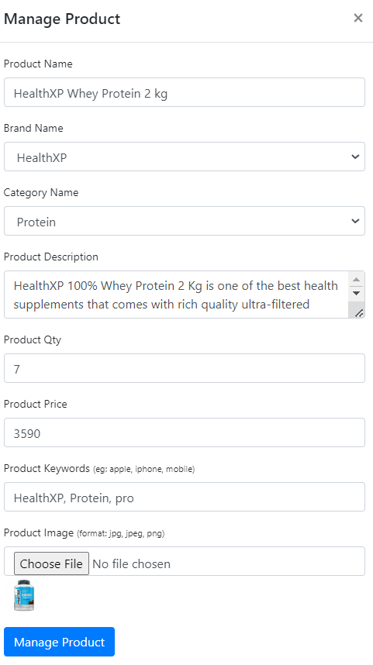
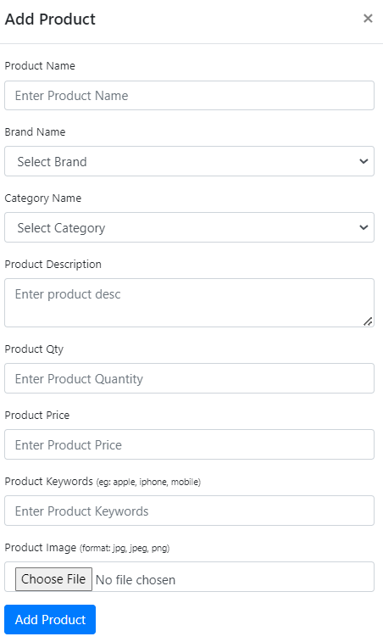
Admin panel - Product
Admin can make actions such as updating or deleting an existing brand, adding a new brand.

Slide 20
Thank You!!

